Slide 1
Session 3
Module 4: Java Security
Module 5: Cryptography

Slide 2
Module 3 - Review (1)
Scrollable result sets provide the ability to move the cursor forward and backward to a specified position or to a position relative to the current position
Updatable resultset is the ability to update rows in a result set using methods in the java programming language rather than SQL commands
A batch update is a set of multiple update statements that is submitted to the database

Slide 3
Module 3 - Review (2)
Rowsets: a set of row from a source of tabular data like a result set. It is derived from the ResultSet interface.
A JDBCRowSet object is derived from ResultSet object. To make a ResultSet object scrollable and thereby make better use.
CachedRowSet stores/caches its data in memory so that it can operate on its own data rather than depending on the data stored in a DB.

Slide 4
Module 4, 5 - Objectives
Java security architecture
Securing java applet
Securing java application
JAAS
Introduction to Cryptography
Java Cryptography Architecture (JCA)
Java Cryptography Extension (JCE)

Slide 5
Introduction to security
The difference between security & safety
Evolution of Java Security
  JDK 1.0 – sandbox security model confine Java Applet
  JDK 1.1 – signed applet packaged as JAR file
  JDK 2 :
    It provides for a consistent & flexible policy for applet & applications.
    The concept Protection Domain: the security policy decoupled from its implementation.

Slide 6
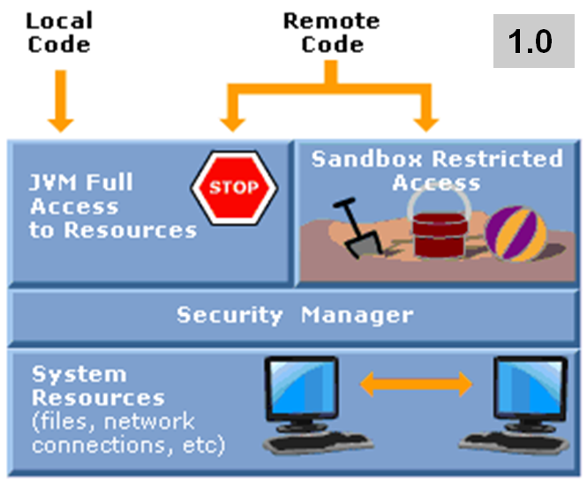
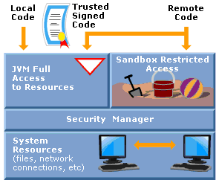
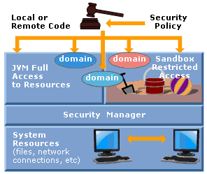
Introduction to security (2)
1.1
2

Slide 7
Java 2 security (1)
Java 2 security model provides a consistent and flexible policy for applets and applications
Features of java 2 security model:
  Byte code verifier
  Class loader
  Code source
Feature of java 2 runtime environment (J2RE)
  Policy file
  Security manager
  Access controller
  Keystore

Slide 8
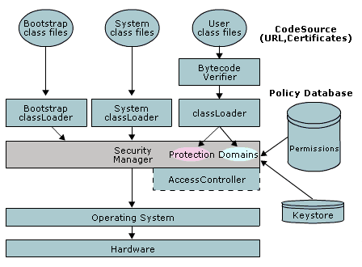
Java 2 security (2)

Slide 9
Goals of java security
Safe from malevolent programs
Non-intrusive
Authenticated
Encrypted
Audited

Slide 10
Java security model
Impact of:
  Object-orientation
  Modern memory model
on Java security enabling to achieve the goal.
Built-in access level in Java: Every member of an object in Java has an access level :
  private
  protected
  default
  public

Slide 11
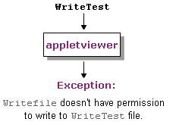
Securing applet
Types of Security Restrictions:
  File Access Restrictions
  Network Restrictions
  Other Security Restrictions

Slide 12
Setting up a Policy File
A policy file is an ASCII text file and can be composed via a text editor or the graphical Policy Tool utility.
There are three steps to create and modify a policy file:
Start Policy Tool
Grant the required permission
Save the Policy File

Slide 13
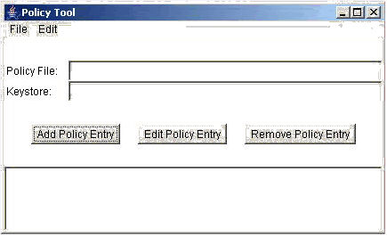
Start Policy Tool

Slide 14
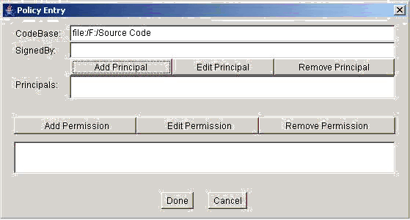
Granting the required permission

Slide 15
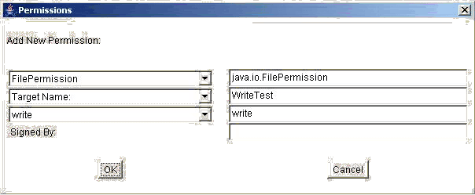
Granting the Permission

Slide 16
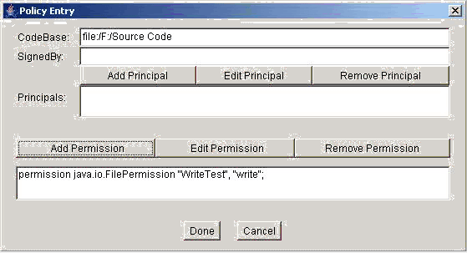
Updating Policy Entry

Slide 17
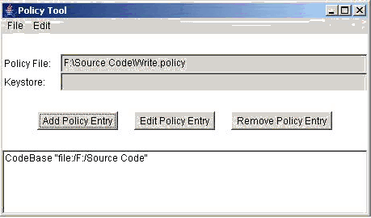
Save the Policy File

Slide 18
Policy File Effects
When you run an applet, the security file named java.security specified the policy files that are loaded & used by default.
2 approaches to ensure policy file Effects
  Specify the policy file as an argument to appletviewer command
  Add a line in the java.security file specify the additional policy file
    An entry for a policy file takes following form:
    policy.url.n = URL
    (n indicates a number, URL is a path of policy file)

Slide 19
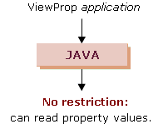
Securing application
Application freedom
  An application trying to access system properties such as os.name, java.version, user.home..

Slide 20
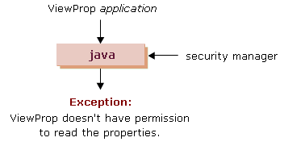
Restricting Applications

Slide 21
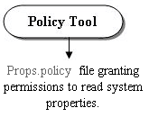
Setting up the policy file (1)
Three steps to set up the policy file to grant the required permissions:
  Start the Policy Tool
  Grant the required permission
  Save the Policy File

Slide 22
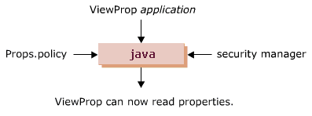
Setting up the policy file (2)
Step 1 – Start the Policy Tool.
Step 2 – Granting the required permissions:
  Adding a Policy Entry
  Granting Permission
  Adding another Policy Entry
  Updating Policy Entry
Step 3 – Saving the policy file.

Slide 23
Introduction to Authentication
Authentication is the process of confirming the identity of an entity (user/computer): using user name & a password.
Authorization (allowing) is the process of granting / denying access to a network resource:
  Authorized User
  Authorization Decision
Disadvantage of code-based authentication.

Slide 24
Introduction to JAAS –
Overview of JAAS
Java Authentication & Authorization Service (JAAS) is an API that enables Java applications to access authentication & access control services without being tied to those services.
JAAS can be used for two purpose:
  Authentication
  Authorization

Slide 25
Using JAAS
1 - Using JASS for Authentication
  LoginContext class with login() method
  Principal class
2 - Using JAAS for Authorization
  doAsPrivilegend() method of Subject class

Slide 26
Definition of Cryptography
To maintain and protect the confidentiality of the information transmitted on a communication medium, encryption is applied
Cryptography is the mechanism of encoding information in a secret coded form.
The term “encrypting” pertains to converting plaintext to ciphertext, which is again decrypted into usable plaintext

Slide 27
Cryptography
The process of cryptography is achieved with the help of encryption algorithm and encryption key
The encryption algorithm is a mathematical procedure to encrypt and decrypt the data
The encryption key is the input that the encryption algorithm takes

Slide 28
Types of Algorithms
Classified based upon the number and types of keys as follows:
  Secret Key Cryptography
  Public Key Cryptography
  Hash functions

Slide 29
Secret Key Cryptography
Transforms the input, called the plaintext, to an output, known as ciphertext, operated by a single secret key.
The two entities taking part in the communication process, must share the same secret key.
Another name, Symmetric Cryptography

Slide 30
Public Key Cryptography
Is similar to the symmetric cryptography, except for the difference that it operates under two different keys instead of one secret key.
One key is used for encoding, the second is used for decoding the data.
Also called, Asymmetric Cryptography

Slide 31
Hash Functions
Makes use of a mathematical hash function to encrypt the information into an irreversible code.
It’s also named as one-way cryptography, as it’s easy to compute but difficult to reverse.

Slide 32
Purpose of Cryptography
Authentication
Privacy/confidentiality
Integrity
Non-repudiation

Slide 33
Java Cryptography Architecture
The Java security API is a new addition to library of Java APIs, to achieve both low-level and high-level security in Java applications
The JCA forms part of the Java security API, is a framework to access and develop cryptographic functionality.

Slide 34
Components of JCA Architecture
The JCA defines two components:
  Cryptographic Service Providers:
    a package or a set of packages defined by the JCA to implement one or more cryptographic services
  Key Management:
    The JCA also defines a database called keystore to manage the library of keys and certificates
    KeyStore class in the java.security package

Slide 35
Cryptographic Service
The Service provider classes provide the functionality of a type of cryptographic algorithm.
Java class for each service: MessageDigest, Signature, KeyPairGenerator, KeyFactory, CertificateFactory, KeyStore…

Slide 36
Java Cryptography Extension
The JCE extends the underlying architecture of JCA framework to implement encryption, key exchange, …
JCA and JCE together provide a complete, platform-independent API to implement cryptography
The JCE forms the core part of Java SDK 1.4

Slide 37
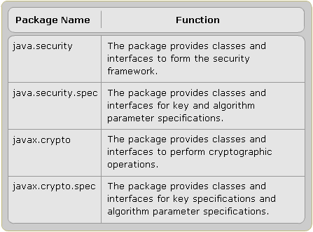
Packages in JCE

Slide 38
Introduction to Cipher
Cipher is the object capable of performing encryption and decryption as per an encryption algorithm.
The Cipher class in the javax.crypto package, form the base of the JCE framework.

Slide 39
Cipher Block (1)
You can encrypt single bits or a block of bits called “cipher blocks”
Block cipher algorithms like BlowFish or DES requires the input to be an exact mutiple of the block size.
The block size is typically of 64 bits or 128 bits.
Single-bit ciphers are called “stream ciphers”

Slide 40
Cipher Block (2)
The short block must be padded with bytes to make it a full block size
There’re many padding techniques, most used technique is PKCS5

Slide 41
Cipher Mode
A cipher mode determines how the encryption will work.
A mode may allow you make the encryption of one block dependent of another block whereas another mode may not allow this.
For example, ECB mode allows a message to be divided into blocks, each block is encrypted separated using a key.

Slide 42
Cipher Object (1)
A cipher object implements a specified transformation.
Cipher objects are created using the getInstance() method of the Cipher class.
  public static Cipher getInstance(String transformation)
  public static Cipher getInstance(String transformation, String povider)
A transformation can have any one of the forms:
  “algorithm/mode/padding”, such as “DES/CBC/PKCS5Padding”
  “(only) algorithm”, such as “DES”

Slide 43
Cipher Object (2)
The Cipher object is initialized by the init() method
  public void init(int opmode, Key key)
The opmode can have any one of the following values
  ENCRYPT_MODE
  DECRYPT_MODE
  WRAP_MODE
  UNWRAP_MODE

Slide 44
Module 4, 5 - Summary (1)
The java 2 security model provides a consistent and flexible policy for applets and applications
No unsigned applet is allowed to access a resource unless the security manager finds that permission has been explicitly granted in a policy file
A security manager is not automatically installed when an application is running
Cryptography is mechanism of encoding information in a secret coded form

Slide 45
Module 4, 5 - Summary (2)
JCA is the java security API is a new addition to library of java APIs. It is a framework written in java to access and develop cryptographic functionality
JCE is a set, it provides implements for encryption, key generation and agreement and message authentication code
Cipher is one of the core classes from JCE. It provides the functionality of a cryptographic cipher used for encryption and decryption

